Slide 1
AI CONSULTING PROPOSAL · SEPTEMBER 2026
Flowstock
Getting the right stock into the right shop, every week.
Prepared for Chleo, Chief Executive
Mid-market sportswear retail · Round 1

Slide 2
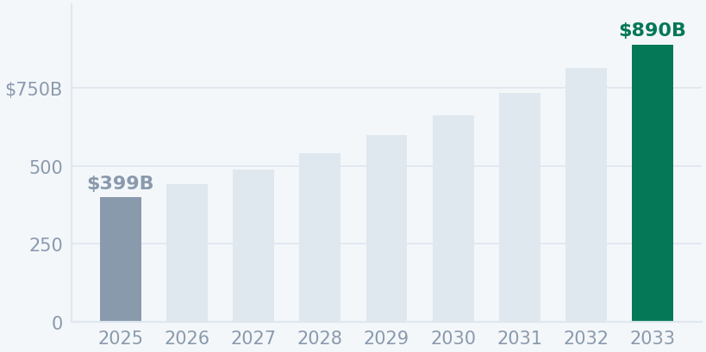
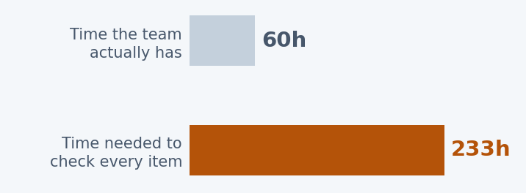
THE MARKET · 01
A growing market — and far too many decisions
THE SPORTSWEAR MARKET WORLDWIDE
STOCK DECISIONS, EVERY WEEK
$399B → $890B by 2033
70 shops × 1,200 products
84,000
separate stock decisions — every single week
Growing 10.7% a year · Europe is 27% of it
5 planners · 10 seconds a decision · a third of their week
Your team is not failing. They are using rough rules of thumb, because that is all that fits in the time.
Grand View Research 2026 · Company profile modelled on a 70-shop chain, using Hibbett Inc. 2024 published figures as the benchmark
Notes:
Two things are happening at once here.
On the left, the market is growing. Sportswear goes from about four hundred
billion dollars today to nearly nine hundred billion by 2033. Europe is more than
a quarter of it. Growth is not your problem.
Your problem is on the right. Seventy shops times twelve hundred products is
eighty-four thousand decisions, every week — how many units of each product go to
each shop.
Now look at the bars. Five planners, ten seconds a decision, about a third of
their week on replenishment. Sixty hours available. Two hundred and thirty-three
hours needed.
I want to be very clear about what that means, because it is not a criticism of
your team. Nobody could do this properly in sixty hours. So they use sensible
rules of thumb — send everyone the same, top up whatever looks low. That is the
correct response to an impossible job. It is also exactly where the money leaks.
[~70 sec]

Slide 3
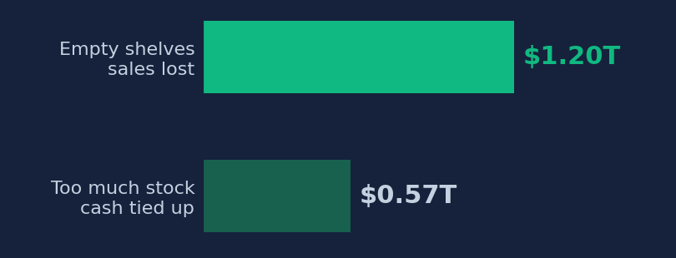
THE COST · 02
The problem is not data. It is speed.
LOST EVERY YEAR — STOCK IN THE WRONG PLACE
HOW A STOCKOUT ACTUALLY PLAYS OUT
$1.77T
A typical week in one shop
DAY 0
A product starts selling faster than usual
That is 6.5% of everything retailers sell worldwide.
DAY 3
The shelf is empty. The customer leaves.
DAY 7
The weekly report finally shows it
DAY 10
New stock arrives in the shop
A week of lost sales before anyone could do anything.
Retailers do not lack numbers. They lack the time to act on them.
IHL Group Inventory Distortion Study 2026 · Timeline is illustrative
Notes:
Here is what that costs the industry. One point seven seven trillion dollars a
year — six and a half percent of everything retailers sell worldwide — lost to
stock sitting in the wrong place. Two thirds of that is empty shelves. The other
third is stock you already paid for that nobody wants.
But the right-hand side is the part I actually want you to remember. This is how
a stockout really plays out.
Day zero, a product starts selling faster than usual. Day three, the shelf is
empty — and that customer has already walked out. Day seven, your weekly report
finally shows it. Day ten, new stock arrives.
That is a week of lost sales before anybody could do anything.
And notice — the data existed on day three. It was sitting in your systems.
Nobody was looking at it, because nobody can look at eighty-four thousand lines
every day.
This is not a data problem. It is a speed problem.
[~70 sec]

Slide 4
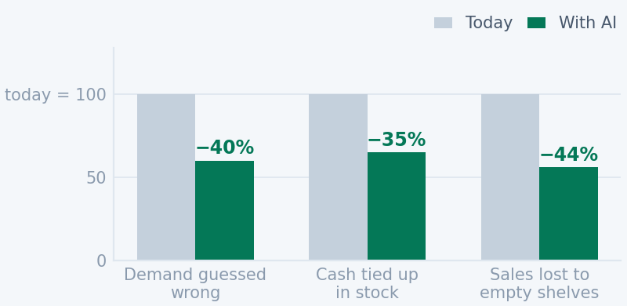
WHAT AI CHANGES · 03
AI works. Trust decides whether it gets used.
WHAT RETAILERS USING AI REPORT
58% of retailers are already using AI in 2026 — up 16 points in a single year.
The system that wins is not the cleverest one. It is the one your team trusts enough to act on.
NVIDIA State of AI in Retail 2026 · McKinsey State of AI 2025–26 · Chart indexed to today = 100, using the midpoint of published ranges
Notes:
So does AI actually fix this? The evidence says yes.
Retailers using AI report around forty percent less error in predicting demand,
a third less cash tied up in stock, and roughly forty percent fewer lost sales.
Fifty-eight percent of retailers are already doing it — up sixteen points in a
single year. This is not experimental any more.
But the number on the right is the one that matters most to you, because it is
your own objection turned into a statistic.
Seventy percent of AI projects that stall fail for one single reason: nobody can
explain how the computer reached its answer. Not because the maths was wrong.
Because a planner looked at the screen, did not understand where the number came
from, and overrode it. And a system nobody uses is worth precisely nothing.
So the system that wins is not the cleverest one. It is the one your team trusts
enough to act on. Everything from here on is built around that sentence.
[~70 sec]

Slide 5
THE SOLUTION · 06
FLOWSTOCK – AI Replenishment Platform
AI
learns from your sales
FIXED RULES
your business limits
YOUR TEAM
a person decides
SYS
AI
AI
FIXED RULES
YOUR TEAM
SYS
YOUR DATA
FORECAST
PRIORITY
THE LIMITS
YOUR PLANNER
THE OUTPUT
Sales and stock
numbers
What will sell,
shop by shop
Which shops
need it most
What is actually
possible
Adjust and
approve
Delivery list for
the warehouse
›
›
›
›
›
Pulled in overnight,
automatically
Learns from your
own sales history
Sends stock where
it earns the most
Warehouse stock,
box sizes, shelf space
Change a line, see
the impact at once
Sorted by route and
delivery day
‹
every change is re-checked instantly
The AI does two jobs
One answer, not a menu
Your team always decides
It works out what will sell, then ranks which shops need the stock most.
Your service target is set once by you — not re-chosen every Monday.
Adjust any line and watch the totals move before you approve it.
The AI predicts and prioritises. Your team still decides — and can always see why.
Concept design for this meeting · Working version to be built next · The priority model needs a few months of history before it beats a simple rule
Notes:
So here is what we propose. And here is the direct answer to your question —
what is "the AI".
Six steps. Your data comes in overnight. Only two of these six have an AI tag.
Forecast learns from your own sales history what each shop will sell over the
next fortnight. Priority ranks which shop earns the most from the next available
unit — because your warehouse never has enough for everyone, and somebody has to
decide who gets it.
Then fixed rules. Warehouse stock, box sizes, shelf space. These are arithmetic,
not predictions, and we deliberately keep a model away from them. If a box holds
six, it holds six.
Then your planner. Adjust any line and the totals move instantly. Nothing ships
until a person approves it, and any change from the recommendation needs a
written reason.
One last thing — one recommendation, not a menu. Your service target is set once,
by you, and reviewed quarterly. Your planner should not be re-choosing your
inventory strategy every Monday morning.
[~80 sec]

Slide 6
BUILT AND RUNNING · 08
This is not a sketch. It runs today.
ONE PLAN, 57,114 SHOP-PRODUCT LINES
WHAT THE PLAN ACTUALLY DID
Sales at risk over 14 days
33,412 units
€1.61m → €799k
−50%
proposed for shipment from the warehouse
Shelves likely to run empty
6,299 lines
17.7% → 8.7%
−9.0 pts
improved against their current position
€814k / €456k
Stock working in shops
projected recovered sales and margin
€16.79m → €17.66m
+€0.87m
3,102 of 4,832
high-risk lines received stock
Warehouse stock drawn down
433,498 → 400,086
−33,412
1,730 lines
got zero — every one with a written reason
Stock did not get cheaper. The same units moved onto shelves that actually sell them.
Reproducible run on the corrected sportswear package, default settings, no manual edits · Simulated outcomes against the supplied forecast, not realised sales
Notes:
I want to be clear that this is not a concept deck. This part runs today.
That is a real plan across fifty-seven thousand shop-product lines. Sales at risk
over the next fortnight halved. Shelves likely to run empty went from seventeen
point seven percent to eight point seven. Thirty-three thousand units proposed,
six thousand three hundred lines improved.
Two numbers matter more than the rest.
Zero shipment rule breaches. Not one line broke a capacity limit or a box size.
And this one: of four thousand eight hundred high-risk lines, three thousand one
hundred received stock, and one thousand seven hundred received nothing — every
single one with a written reason on the screen.
That second part is the trust mechanism. When your planner asks "why did this
shop get nothing", the system answers. No stock. No room. Wrong box size. That is
what stops people overriding it.
These are simulated outcomes against the supplied forecast. Real service and real
margin come from a pilot, and I will get to that.
[~80 sec]

Slide 7
THE ROADMAP · 09
Three things turn this into an AI platform
01
02
03
AI DEMAND FORECAST
AI PRIORITY RANKING
AUTOMATED ORCHESTRATION
Learns what each shop
sells, week by week
Learns which shop earns
most from the next unit
Runs the cycle nightly
and watches itself
Today the plan trusts a supplied forecast. A trained model replaces it and carries its own confidence score.
Today a fixed 50/50 margin-and-service rule ranks the queue. A model learns it from what actually sold.
Today a person starts every run. Scheduled jobs refresh data, produce the plan, alert the planner and monitor accuracy.
WHAT YOU GET
WHAT YOU GET
WHAT YOU GET
Fewer surprises. Stock arrives before the shelf empties, not after.
Scarce warehouse stock lands where it converts, not where the rule guessed.
The planner reviews exceptions instead of starting the machine.
The screen the planner uses does not change. What changes is how good the numbers behind it get.
Each step ships only after it beats what it replaces on held-out data — see the test plan on slide 11
Notes:
If it already works, what is the AI actually for?
Three things.
Today the plan trusts a forecast we are handed. A trained model replaces it and
carries its own confidence score — so the system knows which predictions to rely
on. Fewer surprises.
Today a fixed fifty-fifty rule ranks the queue. A model learns that ranking from
what actually sold, so scarce warehouse stock lands where it converts rather than
where a rule guessed it would.
And today a person has to start every run. Scheduled jobs would refresh the data,
build the plan, alert the planner and watch accuracy on their own.
Here is the part I would underline. The screen your planner uses does not change.
The workflow does not change. What changes is how good the numbers behind it get.
That is deliberate — we are not asking your team to learn a new job.
[~70 sec]

Slide 8
THE EVIDENCE · 12
What we have tested so far
THE CASE
WHAT SHOULD HAPPEN
WHAT HAPPENED
RESULT
Shop short of a fast seller,
warehouse has stock
It receives a
recommended quantity
3,102 of 4,832 high-risk
lines received stock
PASS
Shop short, but the
warehouse is empty
Zero, with the reason
shown on screen
1,730 zeros, each with a
written explanation
PASS
Shelf holds 7, has 5,
pack size is 6
No shipment — it would
not fit
Zero, reason given as
shelf capacity
PASS
A full plan of
33,412 units
No rule broken
anywhere
Zero breaches across
every shipment line
PASS
Planner changes a quantity
without explaining
Approval is blocked
until they do
Blocked, and re-checked
on the server
PASS
The same plan sent for
approval twice
The second one is
refused
Refused — stock cannot be
committed twice
PASS
Every line above comes from a working system running the full sportswear dataset, with default settings and no manual edits. They show the machine behaves correctly, predictably and within your rules. The commercial figures are simulated against the supplied forecast — measured service and margin come from the pilot on real shops.
Reproducible run on the corrected sportswear package · The forecasting pipeline was built and validated on a public retail dataset; a sportswear-specific model is the next build
Notes:
And here is what we have tested so far. Six cases, all from the working system
running your full dataset.
Shop short of a fast seller and the warehouse has stock — it gets a recommended
quantity. Warehouse empty — zero, with the reason shown. Shelf holds seven, has
five, box of six — no shipment, because it would not fit. A full plan of
thirty-three thousand units — not one rule broken. Planner changes a quantity
without explaining — approval blocked until they do.
The last one is for your finance team. The same plan sent for approval twice gets
refused. Stock cannot be committed twice. That protects you from your own users
on a busy morning.
One honest note. The commercial figures are simulated against the supplied
forecast, so they prove the machine behaves correctly and predictably. Measured
service and margin come from the pilot on real shops.
The forecasting pipeline itself was built and validated on a public retail
dataset. A sportswear-specific model is the next piece of work.
[~80 sec]

Slide 9
COST AND TIMELINE · 13
Twenty weeks to a measured answer
NOW
WEEKS 1–6
WEEKS 7–14
WEEKS 15–20
A working prototype
Connect your real data
Build the sportswear forecast
Automate and pilot
Already built and running
One category, one region, ten shops
Train it, test it, prove it beats today
Nightly cycle, measured on real sales
no charge
€17,500
€28,000
€21,000
WHAT IT COMES TO
WHEN IT PAYS FOR ITSELF
Our fees, twenty weeks
€66,500
If the pilot delivers even a quarter of the modelled benefit, €69,000 is repaid in under four months and the cycle keeps running after that.
Software and hosting
€2,500
Your planner, two days a week
your time
Total to a measured result
€69,000
Full modelled benefit was €1.11m a year. A quarter is €277k.
Assumes a €700 day rate, one engineer, your data available by week 2, and one planner released two days a week. Excludes ERP integration work your own IT may need · Not a fixed-price quote
Notes:
What it costs.
The prototype is done — there is no charge for that, it exists.
Weeks one to six, we connect your real data on one category, one region, ten
shops. Weeks seven to fourteen, we build the sportswear forecast and prove it
beats what you do today — and if it does not, that gate stops it. Weeks fifteen
to twenty, we automate the cycle and run the pilot against real sales.
Sixty-nine thousand euros all in, over twenty weeks.
The assumptions are on the slide and I want them visible. A seven-hundred-euro
day rate, one engineer, your data available by week two, and one planner released
two days a week. It excludes any ERP integration your own IT might need. It is an
estimate, not a fixed quote.
On payback. The full modelled benefit was one point one one million a year. I am
not going to promise you that. But if the pilot delivers even a quarter of it,
sixty-nine thousand is repaid in under four months — and the cycle keeps running
after that.
[~85 sec]

Slide 10
WHAT WE ARE ASKING FOR · 14
Six weeks, ten shops, one honest answer
WHAT WE NEED FROM YOU
WHAT YOU GET BACK
1
Two years of sales history
A number, not a promise
Whatever your till system already keeps
Measured service, stock and margin on ten real shops.
2
Today’s stock and assortment
What each shop holds and is allowed to hold
A decision point at week 20
Roll it out, change it, or stop. All three are acceptable answers.
3
One category, one region
Ten shops is enough to prove or disprove this
Everything we build, documented
4
One planner, two days a week
The model, the rules and the evidence stay with you either way.
The person who knows why the rules exist
You asked what “the AI” is. It is a forecast and a ranking, both checked against what really sold, inside a system that shows its reasoning on every line.
Notes:
So what am I actually asking for.
Two years of sales history — whatever your till system already keeps. Today's
stock and assortment. One category, one region, about ten shops. And one planner
for two days a week.
That last one is not a formality. It has to be the person who knows why the rules
exist, because they will tell us things the data never will.
What you get back. A number, not a promise — measured service, stock and margin
on ten real shops. A decision point at week twenty where rolling it out, changing
direction, or stopping are all acceptable answers. And everything we build stays
documented and stays with you, whichever way you decide.
You asked me what "the AI" is. It is a forecast and a ranking, both checked
against what really sold, inside a system that shows its reasoning on every
single line.
Thank you. Happy to take questions.
─────────────────────────────────────────────
LIKELY QUESTIONS
"Why not just buy Blue Yonder or RELEX?"
→ They are priced for retailers above a billion in revenue. At your scale the
licence alone exceeds this entire programme, and you would still be
configuring it in twenty weeks.
"How do I know the forecast will be any good?"
→ You do not, yet, and neither do I. That is what weeks seven to fourteen are
for. The gate on slide 12 refuses to ship a model that does not beat your
current method.
"What if my planners just ignore it?"
→ Then the model is wrong and we need to know. Override rate is a tracked
number in the pilot, not a feeling.
"Is our data good enough?"
→ Probably not perfectly, and we will find that out in weeks one to six. When we
loaded the sample capacity data, every store-category group already exceeded
its stated limit. Finding that early is the point of a pilot.
"Does this fall under the EU AI Act?"
→ Our preliminary view is no high-risk classification — it handles stock and
sales figures, no personal data and no decisions about people. We would
confirm that formally in the next phase.

